Slide 1
Badger
Spencer Bialt, Kevin DeMoura, Zack Flake, Danielle Lopez, Zach Mason

Slide 2

What is Badger?
Badger is a social media application for the Android platform
Users can create and design badges, then award them to their friends
Like an “achievement system”, where the user decides what’s an achievement

Slide 3
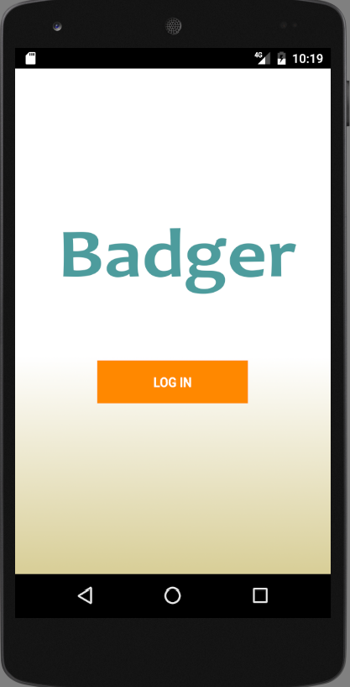
Application Features
Users can login and create accounts using their email address
Friends can be searched for and added via username
Users can create Groups and add their friends to them
Badges can be created from a selection of stock images
Notes:
Valuable for REST API

Slide 4

IDE of choice:
Based on the IntelliJ IDE
Easy Android emulation
Drag-n-drop visual elements
Specific tweaks are possible through direct manipulation of the XML files
Templates for common Android screens are available

Slide 5
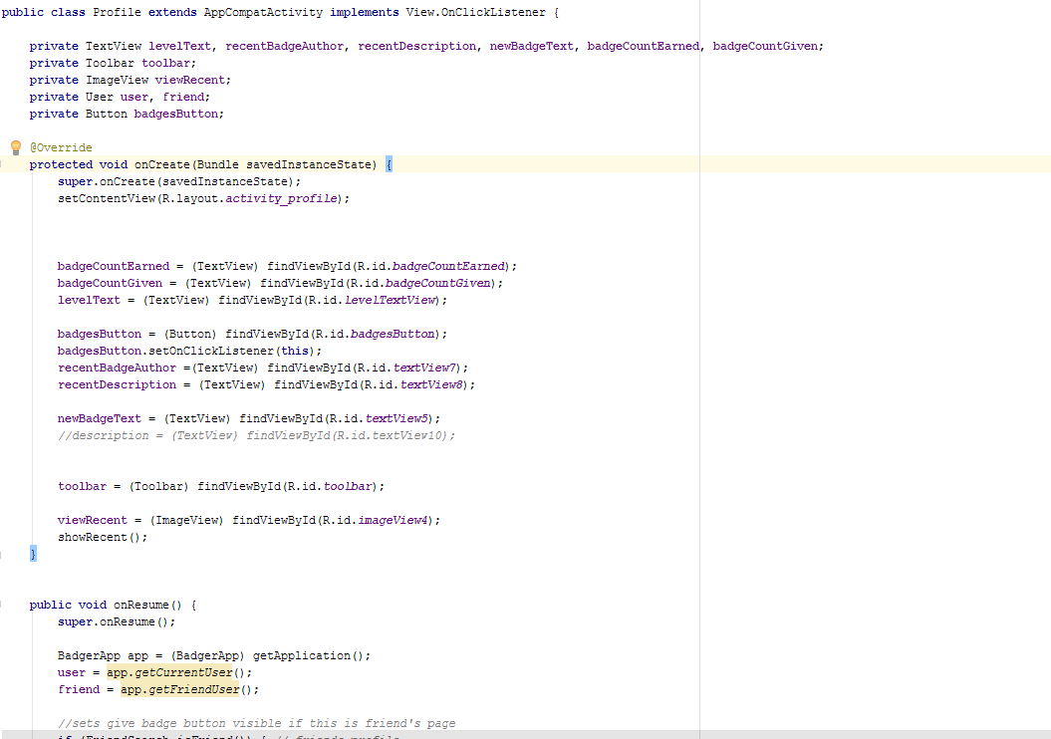
Java code - Profile

Slide 6
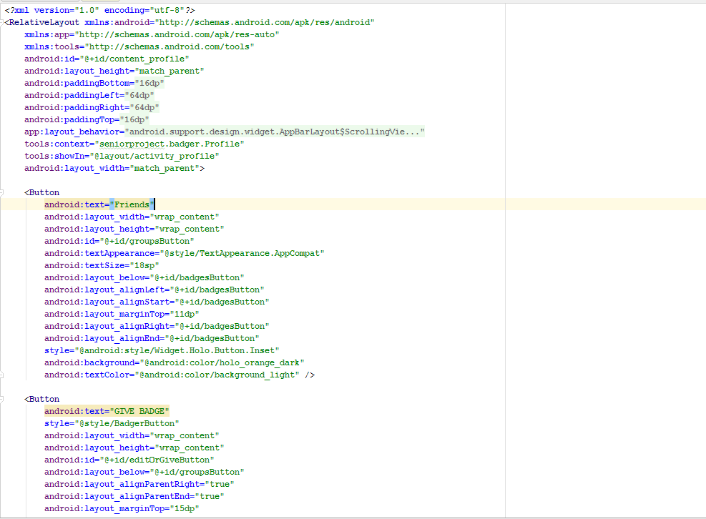
XML

Slide 7
Designing the Database
Friends
Have many
Users
have many
Badges
have and belong to many
Groups

Slide 8




Running the backend
Hosted by AWS
Uses MySQL database engine
Sinatra is similar to Ruby on Rails, with important differences

Slide 9
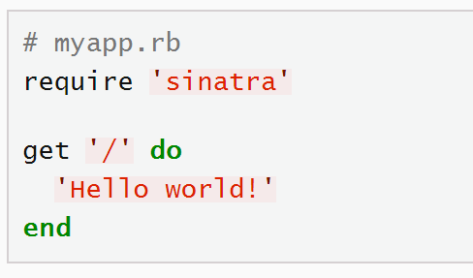
Web Framework: Sinatra
Minimalist web development framework
Code looks exactly like Rails
No boilerplate project structure at all
Extremely quick start time
Notes:
Valuable for REST API

Slide 10
Communicating with the Database
Request from a method
Goes through the Database class
Sends request to database

Slide 11
Code from FriendSearch class
String fName = name.getText().toString();
Database db = new Database();
try {
User user = BadgerApp.getCurrentUser();
User friend = db.getUser(fName);
Log.d("Database", "Matched user: " + friend.getUserName());
String uID = user.getId();
String fID = friend.getId();
if (!db.addFriend(uID, fID)) {
Toast.makeText(getApplicationContext(), "User is already added as friend.", Toast.LENGTH_LONG).show();
return;
}
user = db.getUser(Integer.valueOf(uID));
friend = db.getUser(fName);
((BadgerApp) getApplication()).setCurrentUser(user);
((BadgerApp) getApplication()).setFriendUser(friend);
startActivity(new Intent(this, FriendsList.class));
}
Calls to the Database class
From Database class
public User getUser(String key, String value) throws UserNotFoundException{
JSONObject response = makeGetRequest("/readUser", key + "=" + value);
if (!response.isNull("error")) {
throw new UserNotFoundException(("No user found with that " + key + "."));
}
return new User(response);
}

Slide 12
private JSONObject makeRequest(final String httpMethod, final String endpoint, final String query, final JSONObject request) {
AsyncTask<String, Void, String> task = new AsyncTask<String, Void, String>() {
@Override
protected String doInBackground(String... params) {
StringBuilder sb = new StringBuilder();
try {
HttpURLConnection conn;
String strUrl = API_URL + endpoint;
if (query != null) {
strUrl += "?" + query;
}
URL url = new URL(strUrl);
conn = (HttpURLConnection) url.openConnection();
conn.setRequestProperty("Accept", "application/json");
switch (httpMethod.toUpperCase()) {
case "POST":
conn.setDoOutput(true);
conn.setDoInput(true);
conn.setRequestMethod("POST");
conn.setRequestProperty("Content-Type", "application/json");
OutputStreamWriter wr = new OutputStreamWriter(conn.getOutputStream());
Log.d("Database", "Request: " + request.toString());
wr.write(request.toString());
wr.flush(); break;
case "GET":
Log.d("Database", query);
break;
default:
Exception e = new IllegalArgumentException("Invalid HTTP method given to makeRequest.");
Log.e("Database", e.toString());
throw e;
}

Slide 13






In the future….
Some of the future improvements would be to incorporate other forms of social media such as Facebook or Twitter.
Add more badge options.
To eventually allow the user to create their own badges with a custom drawing tool.
Allow users to create badges from the user’s image gallery.
A chat feature that will allow users to interact with each other through the Badger application.
A report badge button to allow users to report any offensive or vulgar badges that have been created.

Slide 14
Questions.

